Slide 1
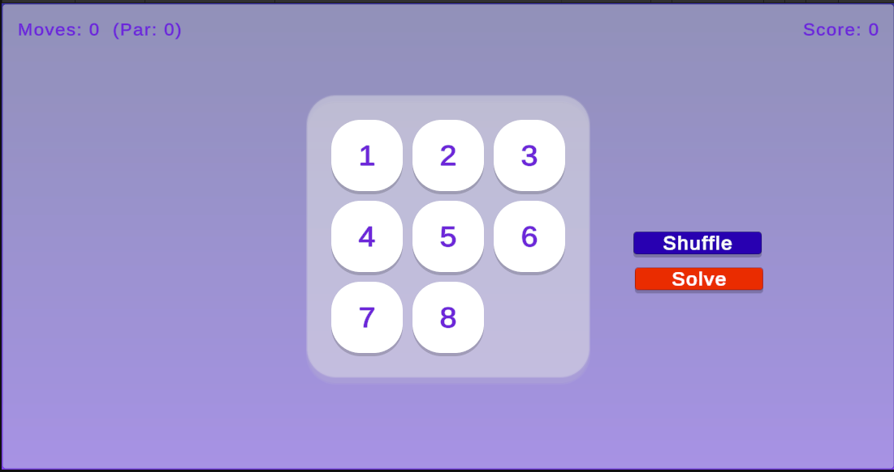
Tim’s Sliding Puzzle
Timothy Hand

Slide 2
Citations and Assets
Solvability check: Wikipedia “15 Puzzle” — en.wikipedia.org/wiki/15_puzzle
No tutorial/paper used algorithms written directly with AI assistance
No external assets used
All UI graphics (rounded cards, gradient background, glow) generated procedurally in C#, not sourced online

Slide 3
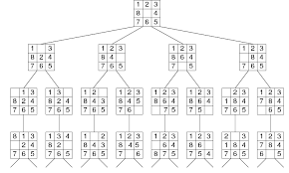
Algorithms
Algorithm: BFS
Issues and solutions
AI Issues: had to swap A* for BFS rewrote solver, re-tuned difficulty per size
Gameplay Issues win screen had no dimming added dark backdrop + modal card
Link to website with playable game

Slide 4
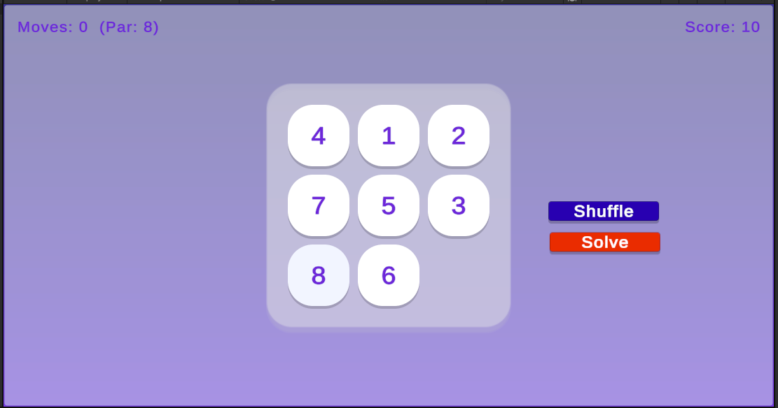
AI use
First prompt: Help me build an 8 puzzle sliding game within unity.
Rejected washed out palette, required BFS over A*, caught real bugs, drove UI fixes

Slide 5

AI
% code written by AI: 100%
Other thoughts: fastest for UI polish + testing; I was still needed a for design taste
% assets generated by AI: 100% (no external assets)

Slide 6
Critique your assignment using Likes/Dislikes.
What should we look for, what should we ignore
Likes
Dislikes
Easy game to get up and running
Didn’t need assets
Easy to expand
Good intro assignment
Overall kind of simple

Slide 7
Demo
Ask for two volunteers to play the game at the end of you demo

